Slide 1
2019 Great Massachusetts Cleanup
Business Sponsor Opportunity
Neil Rhein
Founder & Executive Director
Keep Massachusetts Beautiful

Slide 2
Keep Massachusetts Beautiful Overview
501(c) (3) nonprofit launched in 2014. State-level affiliate of Keep America Beautiful.
Mission: Taking action to make Massachusetts a cleaner, greener place to live, work, and play.
Three core impact areas:
Litter prevention and cleanup: Understand who and what is causing litter and empower volunteer, government, and business resources to clean it up.
Recycling and Waste Reduction: Effective recycling programs reduce the volume of trash that ends up in landfills, incinerators, waterways, and as litter.
Beautification and community greening: Beautifying public spaces builds community pride and spurs local economic activity.

Slide 3
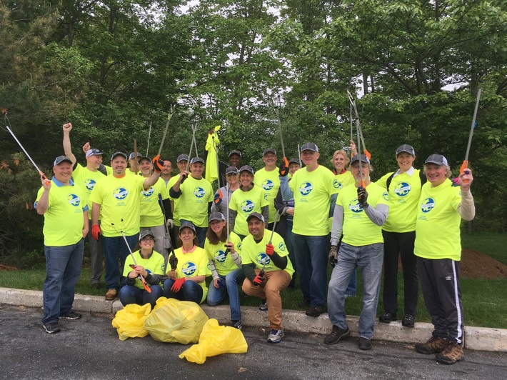
2019 Great Massachusetts Cleanup
Every spring, volunteers in communities across the state organize litter cleanups, park maintenance projects, tree planting, and other community service events as part of the Great Massachusetts Cleanup.
The Great Massachusetts Cleanup is a part of the Great American Cleanup, which engages millions of volunteers across the U.S. each year.
Saturday, April 27 is our suggested event date, but all community cleanups during the 2019 will be included in our 2019 Impact Report.

Slide 4
The Case For Sponsorship
Participating in the Great Massachusetts Cleanup demonstrates your company’s commitment to a clean environment and to the communities in which you operate.
Great Massachusetts Cleanup events make a meaningful impact in Massachusetts communities.
Your support for Keep Massachusetts Beautiful provides your company with positive media exposure.
A clean, litter-free landscape makes Massachusetts a cleaner, greener place for customers and employees.
The Great Massachusetts Cleanup provides your employees with an opportunity to participate in a rewarding community service event.

Slide 5
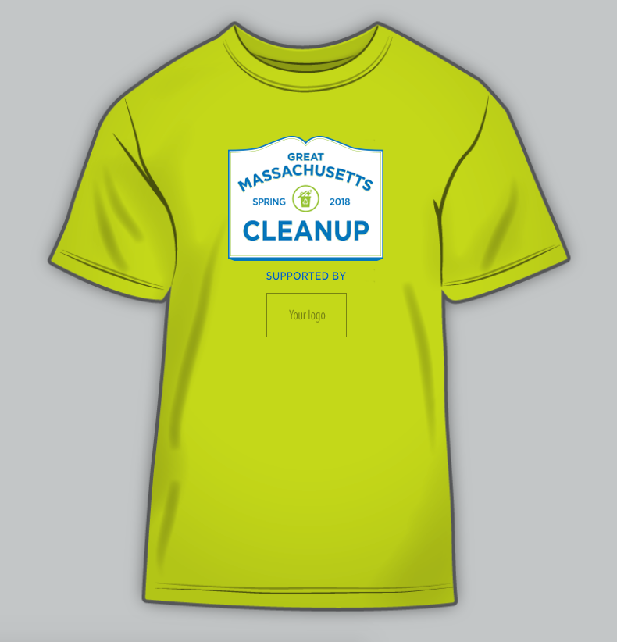
Presenting Sponsor Benefits
Exclusive title sponsorship
Logo on front of volunteer tee shirts (minimum 1,000 shirts)
Logo and link included on Business Partner page on KMB website, plus monthly e-newsletter
Name and logo featured in a minimum of 6 event-related Facebook, Instagram, and Twitter posts
Name and logo included in all press releases about the 2019 Great Massachusetts Cleanup
Sponsorship included in all 2019 editions of Keeping Massachusetts Beautiful, our TV program that is shared on community access TV stations across Massachusetts and on YouTube
Free admission for 8 guests at 2019 Clean Community Awards Gala

Slide 6
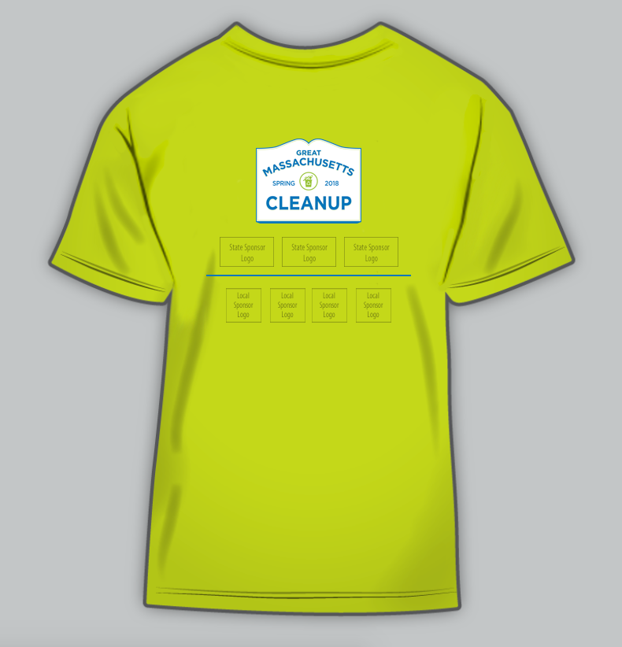
Associate Sponsor Benefits
Logo on back of volunteer tee shirts (minimum 1,000 shirts)
Logo and link included on Business Partner page on KMB website, plus monthly e-newsletter
Name and logo mentioned in a minimum of 3 event-related Facebook, Instagram, and Twitter posts
Name included in all press releases about the 2019 Great Massachusetts Cleanup
Free admission for 4 guests at 2019 Clean Community Awards Gala

Slide 7
Impact: 2018 Great Massachusetts Cleanup

Slide 8
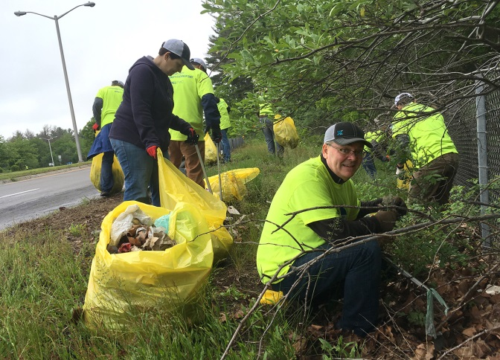
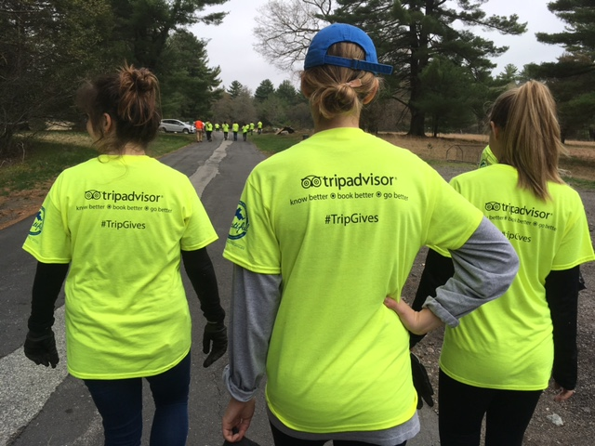
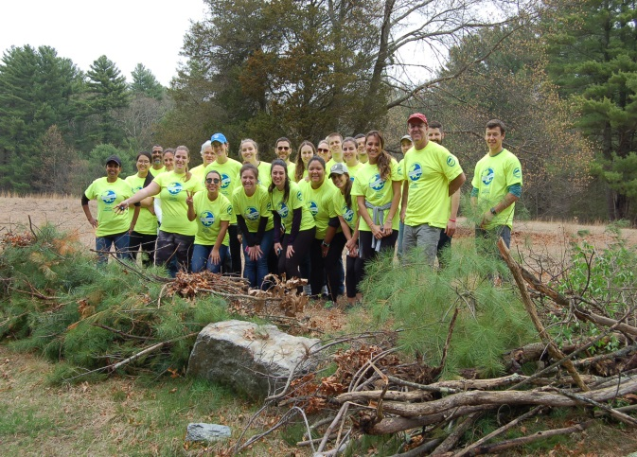
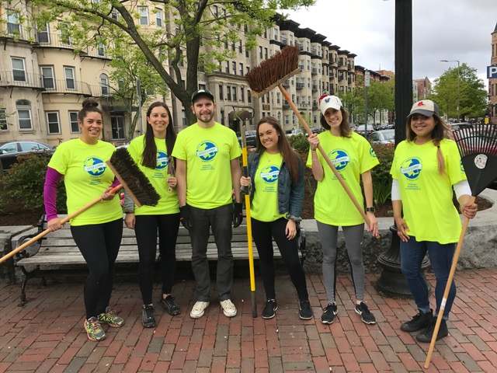
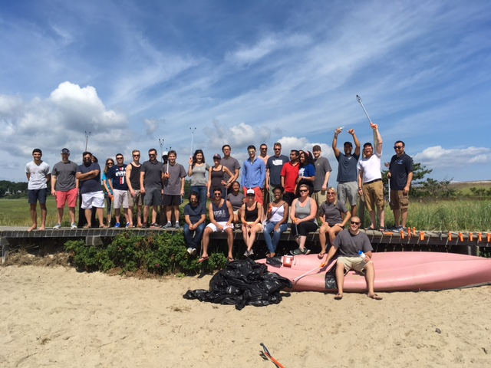
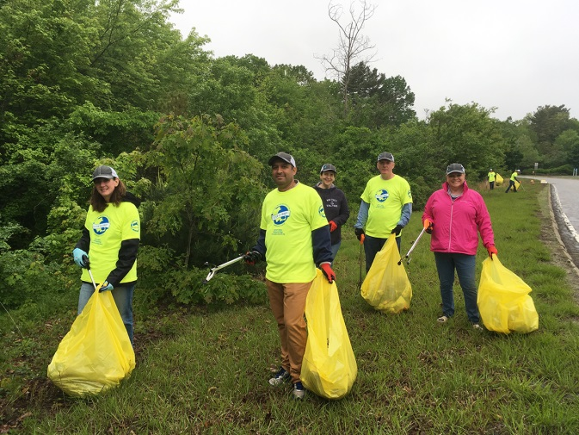
Employee Engagement

Slide 9
Sponsorship Levels
Presenting Sponsor: $10,000
Associate Sponsor: $5,000
Friend of Keep Massachusetts Beautiful: $2,500

Slide 10
Next Steps
Contact Neil Rhein at 508-320-8621 or neil@keepmassbeautiful.org

